Slide 1
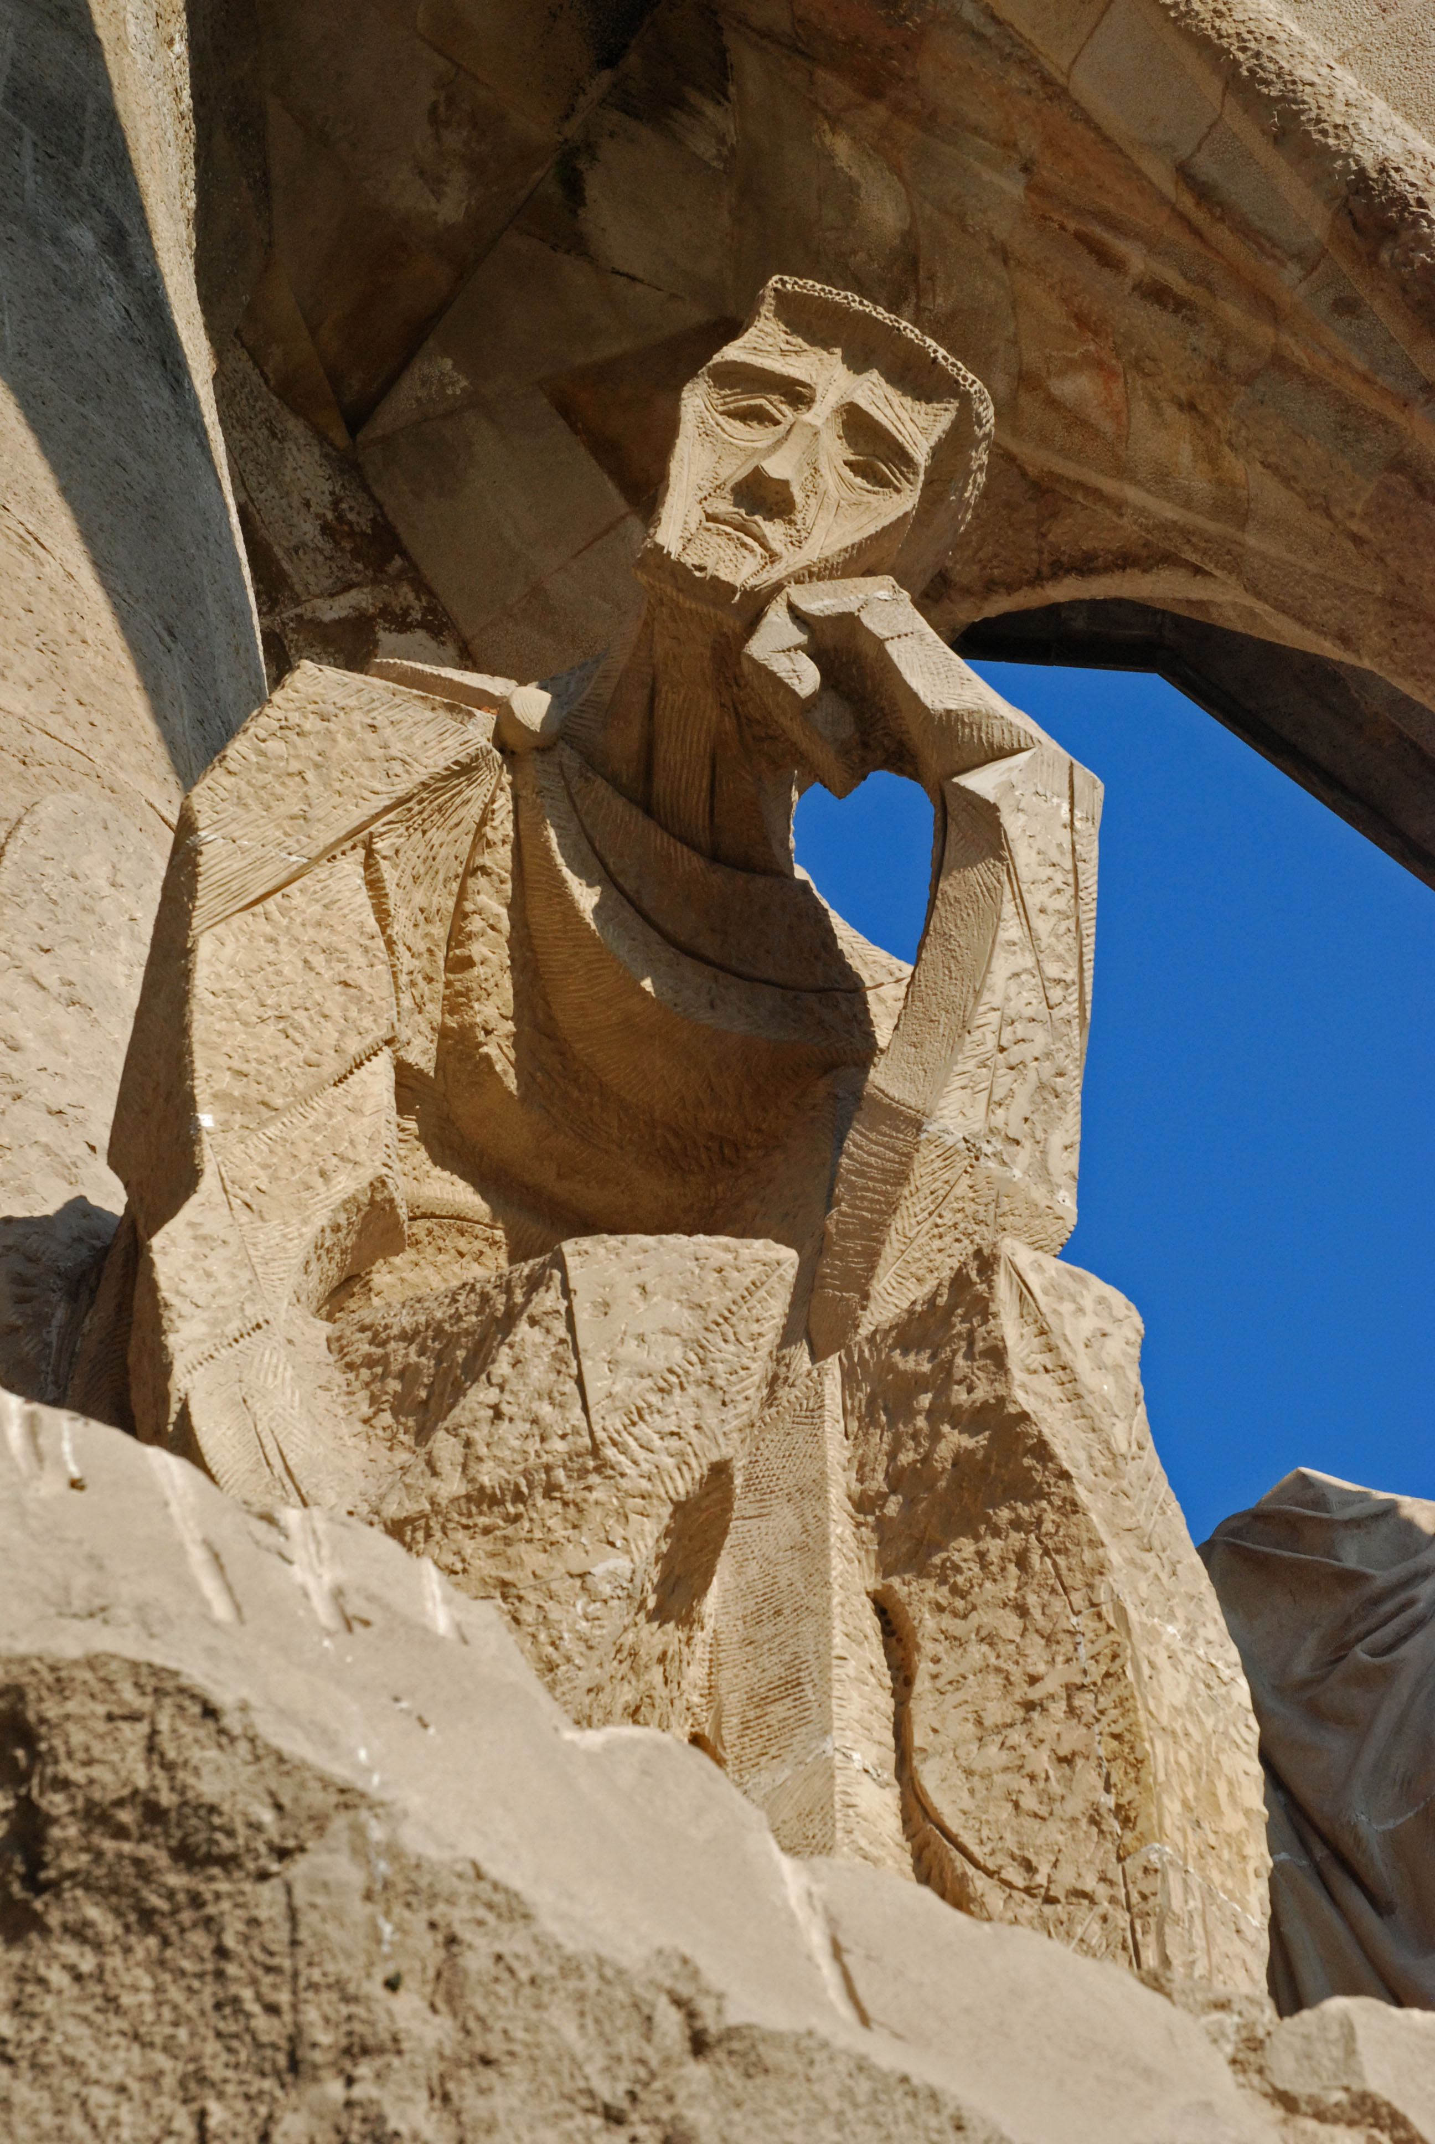
Architectures of Intelligence Lecture 5 Declarative Memory I

Slide 2
Today

Slide 3
Today
Declarative memory: basics
The rational basis for declarative memory
Declarative memory in ACT-R
Example model

Slide 4
Today
Declarative memory: basics
The rational basis for declarative memory
Declarative memory in ACT-R
Example model
Assignment

Slide 5
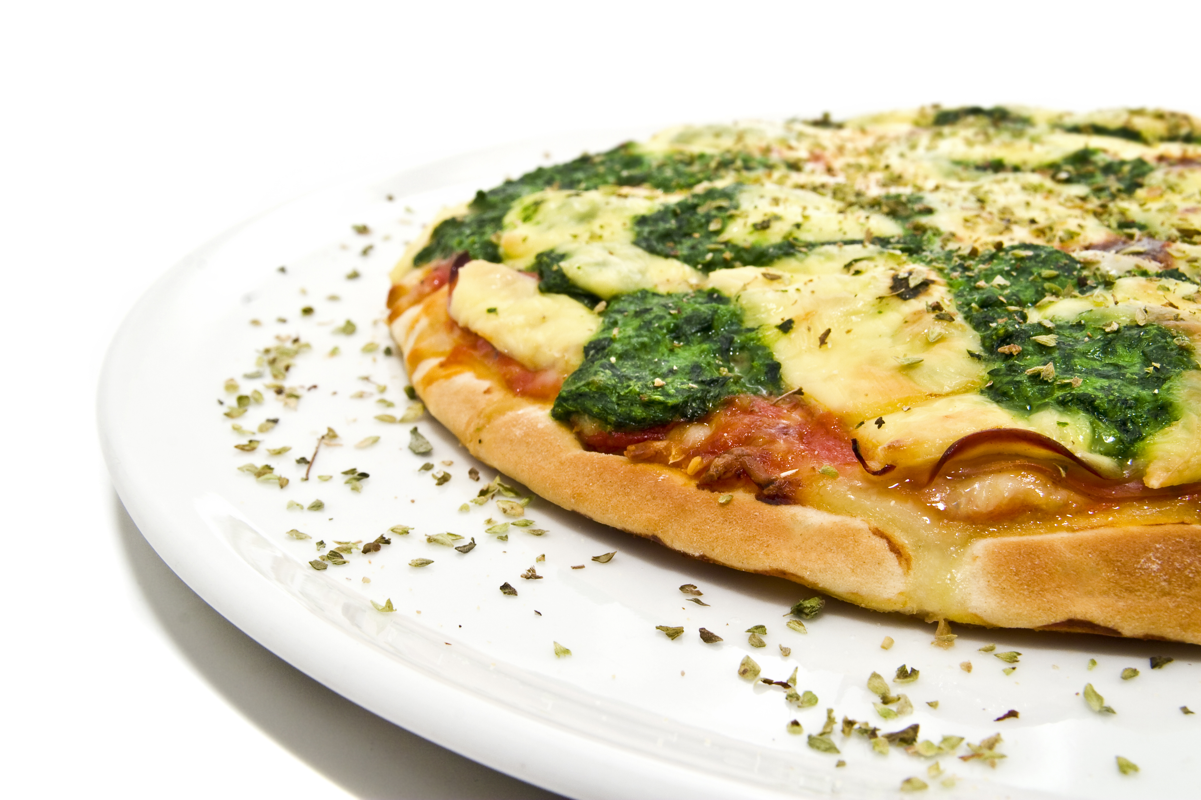
Declarative Memory: Rational Analysis

Slide 6
Declarative Memory
Memory for facts, both semantic and episodic, e.g.:
3+2=5
the past tense of go is went
Yesterday I had pizza for dinner
Notes:
We are typically aware of this knowledge.

Slide 7

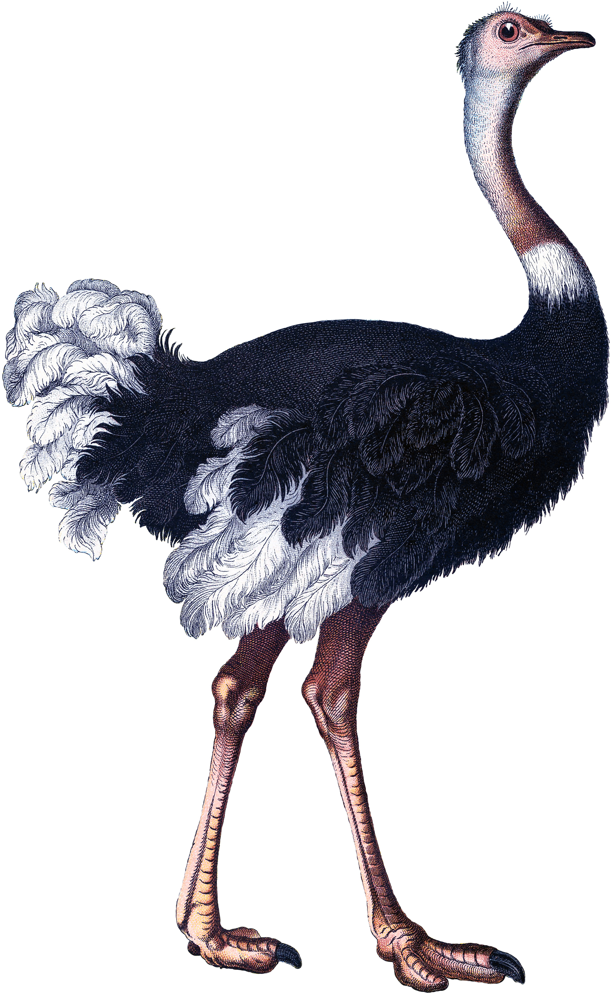
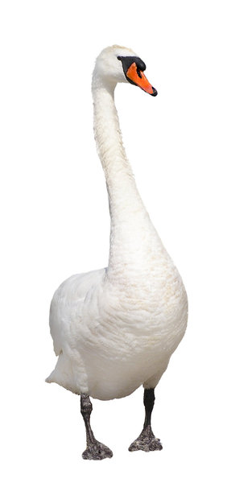
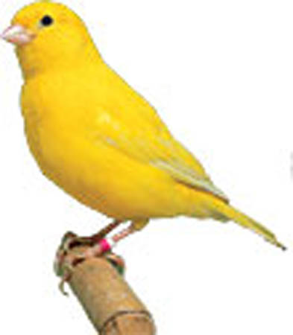
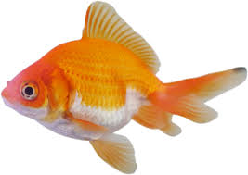
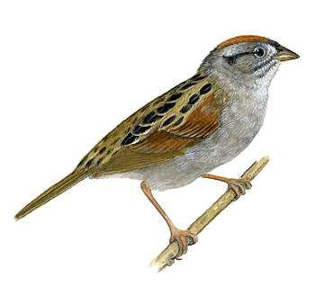
Our memory is full of facts
How can we retrieve what we need, when we need it?
2+3=5
Notes:
Which facts can be retrieved?
How can facts be retrieved under different conditions?
How fast can facts be retrieved?
Why are some facts forgotten?
How does the availablilty of a fact change over time?
...
Why do we store them as facts, rather than as production rules? Because its more versatile -> The same fact can be retrieved in very different scenarios.
Is a canary a bird?
What type of bird does your grandma own?
Is a canary bigger than a sparrow?

Slide 8
Our memory is full of facts
How can we retrieve what we need, when we need it?
What is available?
2+3=5
Notes:
Which facts can be retrieved?
How can facts be retrieved under different conditions?
How fast can facts be retrieved?
Why are some facts forgotten?
How does the availablilty of a fact change over time?
...
Why do we store them as facts, rather than as production rules? Because its more versatile -> The same fact can be retrieved in very different scenarios.
Is a canary a bird?
What type of bird does your grandma own?
Is a canary bigger than a sparrow?

Slide 9
Our memory is full of facts
How can we retrieve what we need, when we need it?
What is available?
Under what circumstances?
2+3=5
Notes:
Which facts can be retrieved?
How can facts be retrieved under different conditions?
How fast can facts be retrieved?
Why are some facts forgotten?
How does the availablilty of a fact change over time?
...
Why do we store them as facts, rather than as production rules? Because its more versatile -> The same fact can be retrieved in very different scenarios.
Is a canary a bird?
What type of bird does your grandma own?
Is a canary bigger than a sparrow?

Slide 10
Our memory is full of facts
How can we retrieve what we need, when we need it?
What is available?
Under what circumstances?
When/how do you forget something?
2+3=5
Notes:
Which facts can be retrieved?
How can facts be retrieved under different conditions?
How fast can facts be retrieved?
Why are some facts forgotten?
How does the availablilty of a fact change over time?
...
Why do we store them as facts, rather than as production rules? Because its more versatile -> The same fact can be retrieved in very different scenarios.
Is a canary a bird?
What type of bird does your grandma own?
Is a canary bigger than a sparrow?

Slide 11
Our memory is full of facts
How can we retrieve what we need, when we need it?
What is available?
Under what circumstances?
When/how do you forget something?
2+3=5
Why don’t we just store everything as production rules?
Notes:
Which facts can be retrieved?
How can facts be retrieved under different conditions?
How fast can facts be retrieved?
Why are some facts forgotten?
How does the availablilty of a fact change over time?
...
Why do we store them as facts, rather than as production rules? Because its more versatile -> The same fact can be retrieved in very different scenarios.
Is a canary a bird?
What type of bird does your grandma own?
Is a canary bigger than a sparrow?

Slide 12
“the memory system […] makes most available those memories most likely to be needed”
(Anderson, 2007, p. 109)
Notes:
Why not everything?

Slide 13
“the memory system […] makes most available those memories most likely to be needed”
(Anderson, 2007, p. 109)
How does it know which memories are most likely to be needed?
Notes:
Why not everything?

Slide 14
The rational basis for declarative memory

Slide 15

The rational basis for declarative memory
Suppose you are a librarian who has to move his library to a smaller building and toss away 50% of the books

Slide 16
The rational basis for declarative memory
Which of these two books would you keep?
Bring this book back before:
Bring this book back before:
14 Jun 90
04 Mar 20
21 Feb 91
10 Apr 20
01 Mar 91
05 May 20
25 Sep 09
21 Jun 20
05 Jan 21
05 Sep 20
21 Nov 20
Notes:
Left: uses spread out over time, last use very recent
Right: higher frequency and all quite recent, but in a bulk
→ Spacing effect: spacing between successive repetitions affects how well the item is remembered

Slide 17
The rational basis for declarative memory
Which of these two books would you keep?
Bring this book back before:
Bring this book back before:
14 Jun 90
04 Mar 20
Frequency
Recency
Spacing
21 Feb 91
10 Apr 20
01 Mar 91
05 May 20
25 Sep 09
21 Jun 20
05 Jan 21
05 Sep 20
21 Nov 20
Notes:
Left: uses spread out over time, last use very recent
Right: higher frequency and all quite recent, but in a bulk
→ Spacing effect: spacing between successive repetitions affects how well the item is remembered

Slide 18
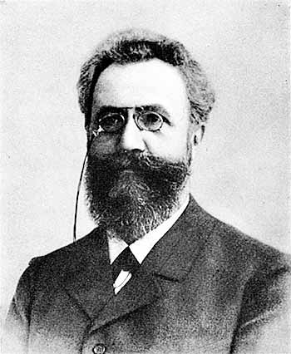
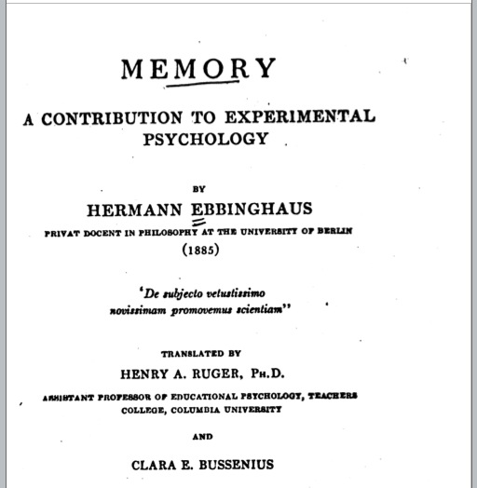
Availability of information in memory Ebbinghaus (1850-1909)
Notes:
Once he had created his collection of syllables, he would pull out a number of random syllables from a box and then write them down in a notebook. Then, to the regular sound of a metronome, and with the same voice inflection, he would read out the syllables, and attempt to recall them at the end of the procedure.

Slide 19
Availability of information in memory Ebbinghaus (1850-1909)
Studied memory with lists of “nonsense syllables”
BOK
YAT
KOJ
...
Notes:
Once he had created his collection of syllables, he would pull out a number of random syllables from a box and then write them down in a notebook. Then, to the regular sound of a metronome, and with the same voice inflection, he would read out the syllables, and attempt to recall them at the end of the procedure.

Slide 20
Availability of information in memory Ebbinghaus (1850-1909)
Ebbinghaus (1885/1913)
Notes:
E learned nonsense syllables.
Right shows relearning the same set on consecutive days, which goes faster and faster.
Left shows relearning them X days after learning them first (starts at 20 minutes).

Slide 21
Availability of information in memory Ebbinghaus (1850-1909)
Forgetting
Ebbinghaus (1885/1913)
Notes:
E learned nonsense syllables.
Right shows relearning the same set on consecutive days, which goes faster and faster.
Left shows relearning them X days after learning them first (starts at 20 minutes).

Slide 22
Availability of information in memory Ebbinghaus (1850-1909)
Forgetting
Practice
Ebbinghaus (1885/1913)
Notes:
E learned nonsense syllables.
Right shows relearning the same set on consecutive days, which goes faster and faster.
Left shows relearning them X days after learning them first (starts at 20 minutes).

Slide 23
Availability of information in memory Ebbinghaus (1850-1909)
Forgetting
Practice
Anderson & Schooler (1991)
Ebbinghaus (1885/1913)
Notes:
Memory of both learning and forgetting seems to adhere to power laws.

Slide 24
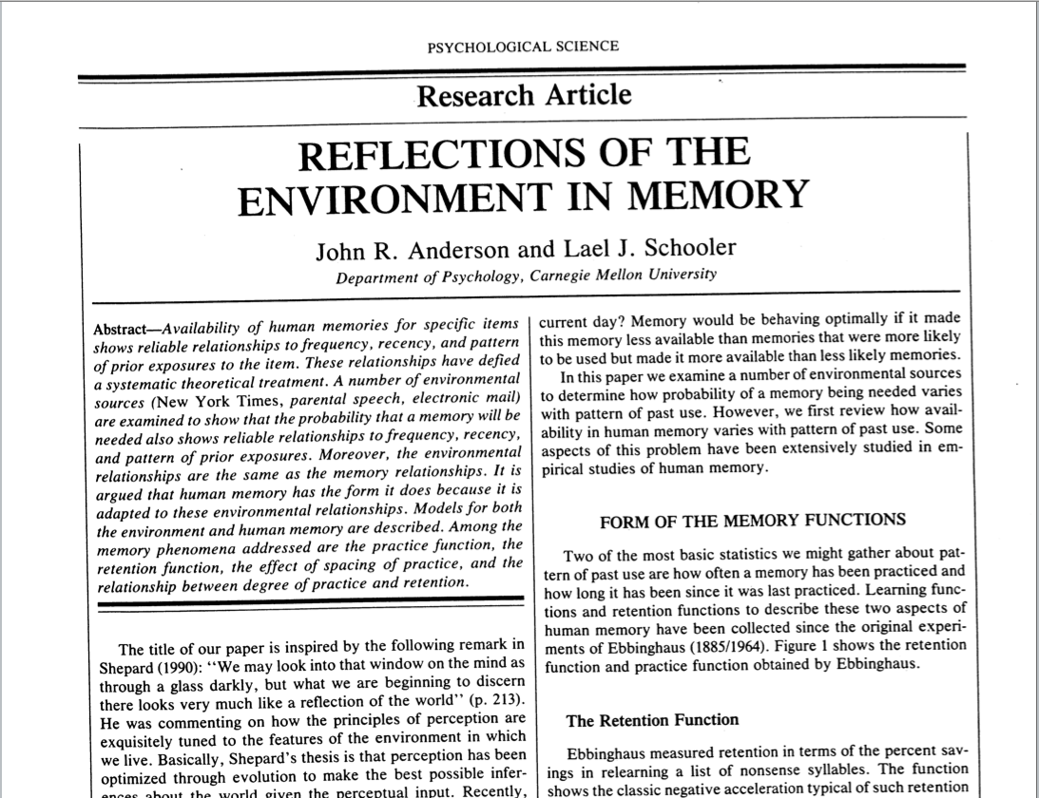
Availability of information in the world

Slide 25
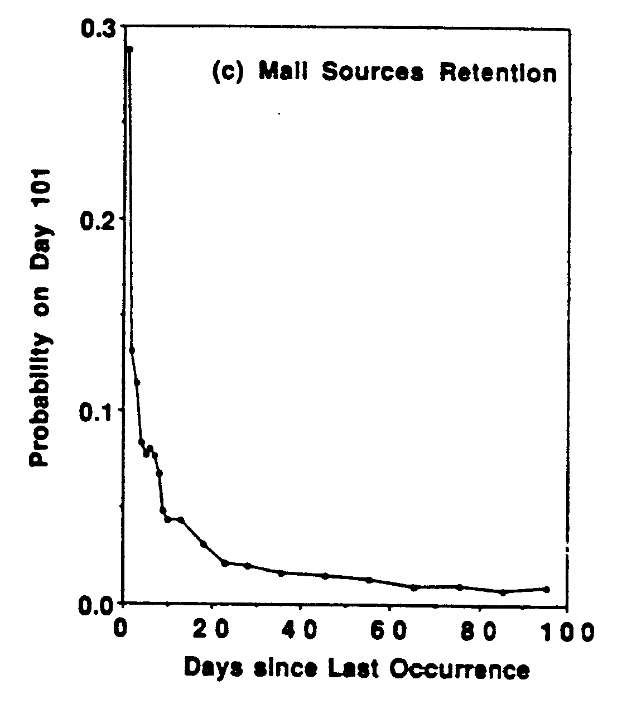
Availability of information in the world
Probability that you will send me an email today as a function of how long ago you last sent me an email

Slide 26
How likely is it that a word appears in the headlines of the New York times?
Notes:
Words in the headlines of the new york times front page 1986-1987
show that the occurrence in the environment is also predicted by a power law. Thus, our memory system is optimized to make use of this environment.

Slide 27
How likely is it that a word appears in the headlines of the New York times?
Notes:
Words in the headlines of the new york times front page 1986-1987
show that the occurrence in the environment is also predicted by a power law. Thus, our memory system is optimized to make use of this environment.

Slide 28
How likely is it that a word appears in the headlines of the New York times?
Notes:
Words in the headlines of the new york times front page 1986-1987
show that the occurrence in the environment is also predicted by a power law. Thus, our memory system is optimized to make use of this environment.

Slide 29
How likely is it that a word appears in the headlines of the New York times?
Notes:
Words in the headlines of the new york times front page 1986-1987
show that the occurrence in the environment is also predicted by a power law. Thus, our memory system is optimized to make use of this environment.

Slide 30
How likely is it that a word appears in the headlines of the New York times?
Notes:
Words in the headlines of the new york times front page 1986-1987
show that the occurrence in the environment is also predicted by a power law. Thus, our memory system is optimized to make use of this environment.

Slide 31
How likely is it that a word appears in the headlines of the New York times?
Notes:
Words in the headlines of the new york times front page 1986-1987
show that the occurrence in the environment is also predicted by a power law. Thus, our memory system is optimized to make use of this environment.

Slide 32
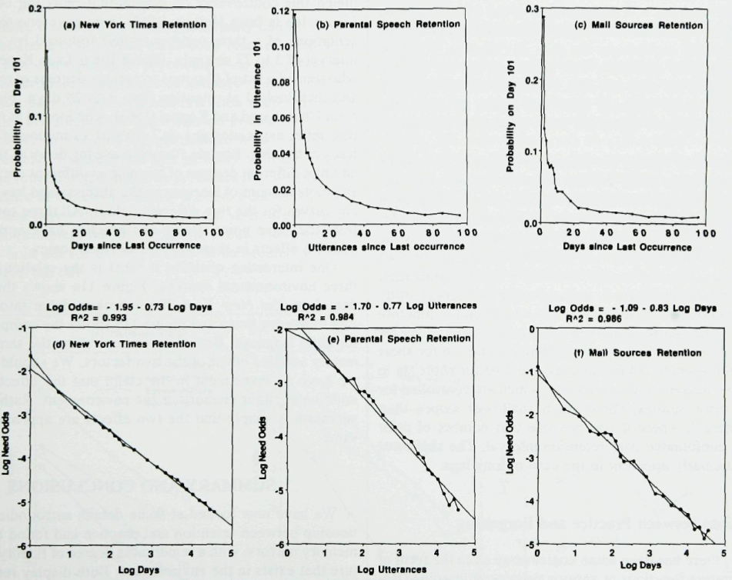
“Reflections of the Environment in Memory” (Anderson & Schooler, 1991)
Notes:
Middle: 25 h of preschool children’s verbal interactions
Right: three years worth of J.A.’s mail messages
Exponential function would mean: During each unit of time, memory loses a constant fraction of what is left
Instead, memory follows a power function:
if both scales are log transformed, there is a linear relationship
Performance goes to infinity as time goes to zero

Slide 33
“Reflections of the Environment in Memory” (Anderson & Schooler, 1991)
Notes:
Middle: 25 h of preschool children’s verbal interactions
Right: three years worth of J.A.’s mail messages
Exponential function would mean: During each unit of time, memory loses a constant fraction of what is left
Instead, memory follows a power function:
if both scales are log transformed, there is a linear relationship
Performance goes to infinity as time goes to zero

Slide 34
Frequency

Slide 35
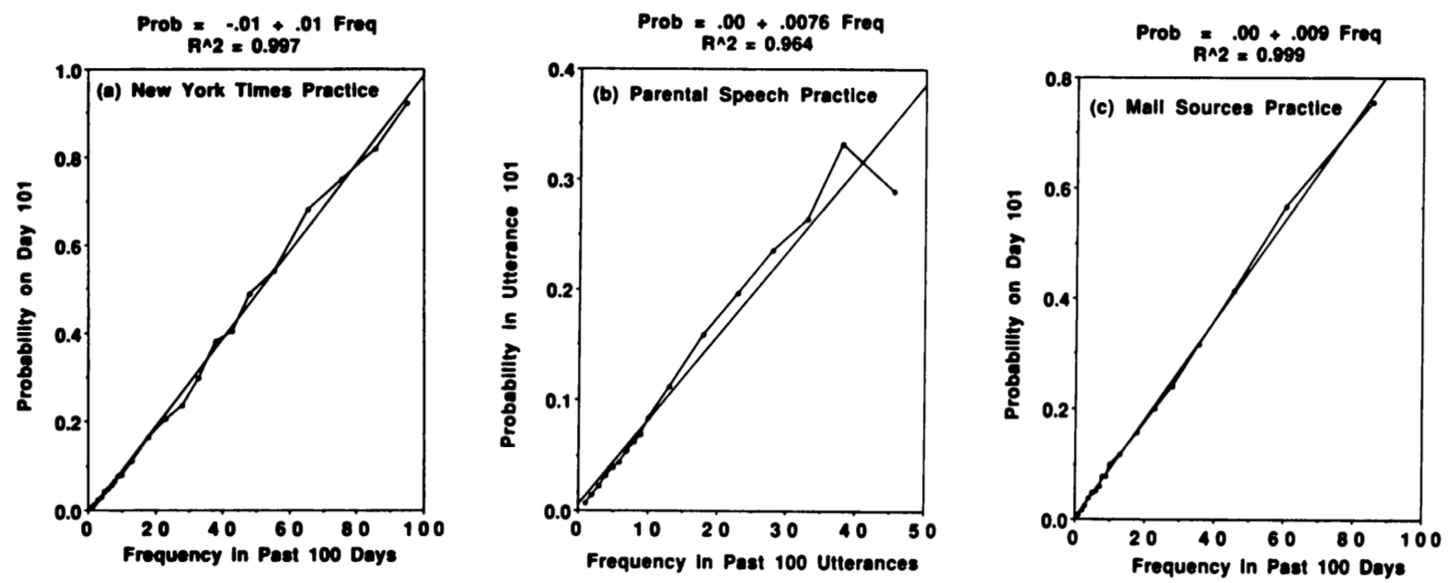
Frequency

Slide 36
Frequency
The availability of information in the world follows a power function
Availability depends on:
Recency: power-law drop-off
Frequency: encounters are additive

Slide 37
Summary

Slide 38
Summary
The availability of information in memory follows a power function (Ebbinghaus)

Slide 39
Summary
The availability of information in memory follows a power function (Ebbinghaus)
The availability of information in the world follows a power function (Anderson & Schooler)

Slide 40
Summary
The availability of information in memory follows a power function (Ebbinghaus)
The availability of information in the world follows a power function (Anderson & Schooler)
Anderson & Schooler imply that this is a causal relationship: our memory is optimally suited for the environment it lives in

Slide 41
Summary
The availability of information in memory follows a power function (Ebbinghaus)
The availability of information in the world follows a power function (Anderson & Schooler)
Anderson & Schooler imply that this is a causal relationship: our memory is optimally suited for the environment it lives in
Availability in both cases depends on the recency & frequency of prior experiences

Slide 42
?

Slide 43
2022 update

Slide 44


2022 update

Slide 45
2022 update
Tweets between 2007-2014 from top 500 tweeters
=> 1,038,632 tweets with on average 7.5 unique strings

Slide 46
2022 update
Tweets between 2007-2014 from top 500 tweeters
=> 1,038,632 tweets with on average 7.5 unique strings
200 comments in 25 discussions of top 501 subreddits on a single day, for April 23 and May 5, 2021
=> 1,133,182 comments, averaging 14.85 strings

Slide 47
Notes:
- not fully parallel
- Many observations, but all long ago ≈ old single observation

Slide 48
These effects also hold for:
- trees visited by Howler monkeys
- locations visited by baboons
- what other chimpanzees a chimpanzee encounters in a day
- which other people German students encounter in a day
(Pachur et al., 2014; Schooler et al., 2000; Stevens et al., 2016)
Notes:
- not fully parallel
- Many observations, but all long ago ≈ old single observation

Slide 49
How does forgetting work?
Forgetting
Notes:
Memory seems to adhere to power laws.

Slide 50
How does forgetting work?
Forgetting
Two theories (mechanisms?) of forgetting
Notes:
Memory seems to adhere to power laws.

Slide 51
How does forgetting work?
Forgetting
Two theories (mechanisms?) of forgetting
Decay: elements in memory fade away if they are not used (ACT-R)
Notes:
Memory seems to adhere to power laws.

Slide 52
How does forgetting work?
Forgetting
Two theories (mechanisms?) of forgetting
Decay: elements in memory fade away if they are not used (ACT-R)
Interference: facts are overwritten by similar facts (nengo)
Notes:
Memory seems to adhere to power laws.

Slide 53
Today
Declarative memory: basics
The rational basis for declarative memory
Declarative memory in ACT-R
Example model
Assignment

Slide 54
DM in ACT-R
Manual
Control
Visual
Perception
Production
System
Declarative
Memory
Problem State
ACT-R
Control
State

Slide 55
Declarative Memory
fact17
isa addition-fact
addend1 1
addend2 7
sum 8
Notes:
size of a chunk

Slide 56
Declarative Memory
Psychologically meaningless
fact17
isa addition-fact
addend1 1
addend2 7
sum 8
Notes:
size of a chunk

Slide 57
Declarative Memory
fact17
isa addition-fact
addend1 1
addend2 7
sum 8
+retrieval>
isa addition-fact
addend1 1
Notes:
size of a chunk

Slide 58
Declarative Memory
fact17
isa addition-fact
addend1 1
addend2 7
sum 8
+retrieval>
isa addition-fact
addend1 1
How long does it take to retrieve a fact?
Notes:
size of a chunk

Slide 59
Declarative Memory
fact17
isa addition-fact
addend1 1
addend2 7
sum 8
+retrieval>
isa addition-fact
addend1 1
How long does it take to retrieve a fact?
Can it be retrieved at all?
Notes:
size of a chunk

Slide 60
Declarative Memory
fact17
isa addition-fact
addend1 1
addend2 7
sum 8
+retrieval>
isa addition-fact
addend1 1
How long does it take to retrieve a fact?
Can it be retrieved at all?
Which one is retrieved?
fact13
isa addition-fact
addend1 1
addend2 3
sum 4
Notes:
size of a chunk

Slide 61
Declarative Memory
fact17
isa addition-fact
addend1 1
addend2 7
sum 8
+retrieval>
isa addition-fact
addend1 1
How long does it take to retrieve a fact?
Can it be retrieved at all?
Which one is retrieved?
How do we learn those chunks?
fact13
isa addition-fact
addend1 1
addend2 3
sum 4
Notes:
size of a chunk

Slide 62
Declarative Memory
fact17
isa addition-fact
addend1 1
addend2 7
sum 8
+retrieval>
isa addition-fact
addend1 1
How long does it take to retrieve a fact?
Can it be retrieved at all?
Which one is retrieved?
How do we learn those chunks?
How do we forget them?
fact13
isa addition-fact
addend1 1
addend2 3
sum 4
Notes:
size of a chunk

Slide 63
Activation
Notes:
activation level == subsymbolic

Slide 64
Activation
Notes:
activation level == subsymbolic

Slide 65
Activation
base-level
activation
Notes:
activation level == subsymbolic

Slide 66
Activation
base-level
activation
spreading
activation
Notes:
activation level == subsymbolic

Slide 67
Activation
base-level
activation
mismatch
penalty
spreading
activation
Notes:
activation level == subsymbolic

Slide 68
Activation
base-level
activation
noise
mismatch
penalty
spreading
activation
Notes:
activation level == subsymbolic

Slide 69
Activation
For now:
Notes:
activation level == subsymbolic

Slide 70
Activation
For now:
Notes:
activation level == subsymbolic

Slide 71
Activation
Notes:
activation level == subsymbolic

Slide 72
Activation
Notes:
activation level == subsymbolic

Slide 73
Activation
Determines:
if a chunk can be retrieved:
Notes:
activation level == subsymbolic

Slide 74
Activation
Determines:
if a chunk can be retrieved:
retrieval threshold
Notes:
activation level == subsymbolic

Slide 75
Activation
Determines:
if a chunk can be retrieved:
which chunk is retrieved: highest
retrieval threshold
Notes:
activation level == subsymbolic

Slide 76
Activation
Determines:
if a chunk can be retrieved:
which chunk is retrieved: highest
retrieval time:
retrieval threshold
Notes:
activation level == subsymbolic

Slide 77
Activation
Determines:
if a chunk can be retrieved:
which chunk is retrieved: highest
retrieval time:
retrieval threshold
latency factor
Notes:
activation level == subsymbolic

Slide 78
Retrieval Time

Slide 79
Retrieval Time

Slide 80
Retrieval Time
retrieval threshold

Slide 81
retrieval success
retrieval threshold

Slide 82
retrieval failure
retrieval success
retrieval threshold

Slide 83
Activation
Notes:
important: this makes our memory tractable: otherwise we would have to sort through everything

Slide 84
Activation
A_{i} estimates the odds that a fact is needed in the current context
Notes:
important: this makes our memory tractable: otherwise we would have to sort through everything

Slide 85
Activation
A_{i} estimates the odds that a fact is needed in the current context
Notes:
important: this makes our memory tractable: otherwise we would have to sort through everything

Slide 86
Activation
A_{i} estimates the odds that a fact is needed in the current context
base-level activation: odds regardless of context
Notes:
important: this makes our memory tractable: otherwise we would have to sort through everything

Slide 87
Activation
A_{i} estimates the odds that a fact is needed in the current context
base-level activation: odds regardless of context
influence of current context
Notes:
important: this makes our memory tractable: otherwise we would have to sort through everything

Slide 88
Base-Level Activation

Slide 89
Base-Level Activation
Reflects the odds that you need a chunk based on frequency and recency

Slide 90
Odds

Slide 91
Odds
Odds is the probability of an event occurring compared to it not occurring:

Slide 92
Odds
Odds is the probability of an event occurring compared to it not occurring:
Odds of 3 means that an event is 3 times as likely to occur than not to occur

Slide 93
Odds
Odds is the probability of an event occurring compared to it not occurring:
Odds of 3 means that an event is 3 times as likely to occur than not to occur
Odds of 1 is 50/50

Slide 94
Base-Level Activation
Reflects the odds that you need a chunk based on frequency and recency

Slide 95
Base-Level Activation
Reflects the odds that you need a chunk based on frequency and recency
For a single presentation of a chunk:

Slide 96
Base-Level Activation
Reflects the odds that you need a chunk based on frequency and recency
For a single presentation of a chunk:
time since last use

Slide 97
Base-Level Activation
Reflects the odds that you need a chunk based on frequency and recency
For a single presentation of a chunk:
decay parameter
time since last use

Slide 98
Base-Level Activation

Slide 99
Base-Level Activation
Reflects the odds that you need a chunk based on frequency and recency
For a single presentation:

Slide 100
Base-Level Activation
Reflects the odds that you need a chunk based on frequency and recency
For a single presentation:
Presentations are additive (practice):

Slide 101
Base-Level Activation

Slide 102
Base-Level Activation
Notes:
activation can be negative!

Slide 103
?

Slide 104
Base-Level Activation

Slide 105
Base-Level Activation
n presentations

Slide 106
Base-Level Activation
n presentations
time since nth presentation

Slide 107
Base-Level Activation
n presentations
decay parameter
time since nth presentation

Slide 108
What is a presentation?
n presentations
decay parameter
time since nth presentation

Slide 109
What is a presentation?
n presentations
decay parameter
Creation of a chunk
time since nth presentation

Slide 110
What is a presentation?
n presentations
decay parameter
Creation of a chunk
Buffer clearing / merging
time since nth presentation

Slide 111
What is a presentation?
n presentations
decay parameter
Creation of a chunk
Buffer clearing / merging
Buffer clearing after retrieval: rehearsal!
time since nth presentation

Slide 112
What is a presentation?
Notes:
What is the problem with this equation?

Slide 113
What is a presentation?
For every retrieval, ACT-R has to calculate the activity of matching chunks by summing over all presentations
Notes:
What is the problem with this equation?

Slide 114
What is a presentation?
For every retrieval, ACT-R has to calculate the activity of matching chunks by summing over all presentations
Computationally expensive
Notes:
What is the problem with this equation?

Slide 115
What is a presentation?
For every retrieval, ACT-R has to calculate the activity of matching chunks by summing over all presentations
Computationally expensive
Implies that we store all encounters
Notes:
What is the problem with this equation?

Slide 116
Optimized Learning

Slide 117
Optimized Learning
Optimized learning:

Slide 118
Optimized Learning
Optimized learning:
decay parameter

Slide 119
Optimized Learning
Optimized learning:
n presentations
decay parameter

Slide 120
Optimized Learning
Time since first presentation
Optimized learning:
n presentations
decay parameter

Slide 121
Optimized Learning
Normal

Slide 122
Optimized Learning
Normal
Optimized

Slide 123
Optimized Learning
Normal
Optimized
Optimized + 1 Normal

Slide 124
Activation
base-level
activation
noise
Notes:
activation level == subsymbolic

Slide 125
Activation
noise
Notes:
activation level == subsymbolic

Slide 126
Noise

Slide 127
Noise
added at retrieval

Slide 128
Noise
added at retrieval
associated with a chunk

Slide 129
Noise

Slide 130
Noise
Logistic Distribution

Slide 131
Activation
noise
Notes:
activation level == subsymbolic

Slide 132
Activation
Notes:
activation level == subsymbolic

Slide 133
Recall Probability

Slide 134
Recall Probability

Slide 135
Recall Probability
retrieval threshold

Slide 136
Recall Probability
retrieval threshold
activation

Slide 137
Recall Probability
retrieval threshold
activation
noise variance

Slide 138
Recall Probability
retrieval threshold

Slide 139
Example: s=0.1, two chunks with A_{A}=0.2 and A_{B}=0.3
retrieval threshold
Chunk A
Chunk B
activation
Notes:
Noise makes the curves flatter
-> increases the change that the chunk with lower activation is increased
-> and that no chunk at all is retrieved

Slide 140
Example: s=0.1, two chunks with A_{A}=0.2 and A_{B}=0.3
retrieval threshold
Which chunk is more likely to be retrieved?
Chunk A
Chunk B
activation
Notes:
Noise makes the curves flatter
-> increases the change that the chunk with lower activation is increased
-> and that no chunk at all is retrieved

Slide 141
Example: s=0.1, two chunks with A_{A}=0.2 and A_{B}=0.3
retrieval threshold
Which chunk is more likely to be retrieved?
P(A)=0.31
P(B)=0.51
P(failure)=0.19
Chunk A
Chunk B
activation
Notes:
Noise makes the curves flatter
-> increases the change that the chunk with lower activation is increased
-> and that no chunk at all is retrieved

Slide 142
Example: s=0.1, two chunks with A_{A}=0.2 and A_{B}=0.3
retrieval threshold
Which chunk is more likely to be retrieved?
P(A)=0.31
P(B)=0.51
P(failure)=0.19
Chunk A
Chunk B
How does noise affect the shape of these curves?
activation
Notes:
Noise makes the curves flatter
-> increases the change that the chunk with lower activation is increased
-> and that no chunk at all is retrieved

Slide 143
?

Slide 144
Parameters
Notes:
activation level == subsymbolic

Slide 145
Parameters
Notes:
activation level == subsymbolic

Slide 146
Parameters
Enable subsymbolic computation :esc nil or t
Notes:
activation level == subsymbolic

Slide 147
Parameters
:bll
nil or .5
Enable subsymbolic computation :esc nil or t
Notes:
activation level == subsymbolic

Slide 148
Parameters
:bll
nil or .5
Enable subsymbolic computation :esc nil or t
Notes:
activation level == subsymbolic

Slide 149
Parameters
:bll
nil or .5
Enable subsymbolic computation :esc nil or t
Optimized Learning :ol nil, t, >0
Notes:
activation level == subsymbolic

Slide 150
Parameters
:bll
nil or .5
Enable subsymbolic computation :esc nil or t
Optimized Learning :ol nil, t, >0
Retrieval treshold :rt #
Notes:
activation level == subsymbolic

Slide 151
Parameters
:bll
nil or .5
Enable subsymbolic computation :esc nil or t
Optimized Learning :ol nil, t, >0
Retrieval treshold :rt #
Notes:
activation level == subsymbolic

Slide 152
Parameters
:bll
nil or .5
:ans
nil or >0
:pas
nil or >0
Enable subsymbolic computation :esc nil or t
Optimized Learning :ol nil, t, >0
Retrieval treshold :rt #
Notes:
activation level == subsymbolic

Slide 153
Parameters
:bll
nil or .5
:ans
nil or >0
:pas
nil or >0
Enable subsymbolic computation :esc nil or t
Optimized Learning :ol nil, t, >0
Retrieval treshold :rt #
Notes:
activation level == subsymbolic

Slide 154
Parameters
:bll
nil or .5
:ans
nil or >0
:pas
nil or >0
Enable subsymbolic computation :esc nil or t
Optimized Learning :ol nil, t, >0
Retrieval treshold :rt #
Notes:
activation level == subsymbolic

Slide 155
Parameters
:bll
nil or .5
:lf >0
:ans
nil or >0
:pas
nil or >0
Enable subsymbolic computation :esc nil or t
Optimized Learning :ol nil, t, >0
Retrieval treshold :rt #
Notes:
activation level == subsymbolic

Slide 156
Parameters
:bll
nil or .5
:lf >0
:ans
nil or >0
:pas
nil or >0
Enable subsymbolic computation :esc nil or t
Optimized Learning :ol nil, t, >0
Retrieval treshold :rt #
Show all parameters: (sgp)
Notes:
activation level == subsymbolic

Slide 157
Today
Declarative memory: basics
The rational basis for declarative memory
Declarative memory in ACT-R
Example model
Assignment

Slide 158
Example Model: Paired Associates Anderson (1981)

Slide 159
Experiment

Slide 160
tent

Slide 161
2

Slide 162
zinc

Slide 163
9

Slide 164
tent

Slide 165
Results
20 paired associates, 8 repetitions

Slide 166
Results
20 paired associates, 8 repetitions
Accuracy

Slide 167
Results
20 paired associates, 8 repetitions
Accuracy
Response Time

Slide 168
Memorizing Paired Associates

Slide 169
Memorizing Paired Associates
Word

Slide 170
Memorizing Paired Associates
Word

Slide 171
Memorizing Paired Associates
Word
Number

Slide 172
Memorizing Paired Associates
Word
Number

Slide 173
Memorizing Paired Associates

Slide 174
Retrieving Paired Associates

Slide 175
Retrieving Paired Associates
Read Word

Slide 176
Retrieving Paired Associates
Read Word

Slide 177
Retrieving Paired Associates
Read Word
Retrieval

Slide 178
Retrieving Paired Associates
Read Word
Retrieval

Slide 179
Retrieving Paired Associates
Read Word
Retrieval Error

Slide 180
Retrieving Paired Associates
Read Word
Retrieval Error

Slide 181
Fitting the Model
Accuracy
Response Time

Slide 182
Fitting the Model
Accuracy
Response Time

Slide 183
Fitting the Model
Accuracy
Response Time

Slide 184
Fitting the Model
Accuracy
Response Time

Slide 185
Fitting the Model
Accuracy
Response Time

Slide 186
Fitting the Model

Slide 187
Fitting the Model
Activation trace: :act t

Slide 188
Fitting the Model
Activation trace: :act t

Slide 189
Fitting the Model
Activation trace: :act t

Slide 190
Fitting the Model
Activation trace: :act t

Slide 191
Today
Declarative memory: basics
The rational basis for declarative memory
Declarative memory in ACT-R
Example model
Assignment

Slide 192
B + 2 = D

Slide 193
C + 4 = F

Slide 194
Alphabet Arithmetic
Verify equations with letters, e.g.
A + 3 = D
C + 2 = F
✔
✗
(Zbrodoff, 1995)

Slide 195
Alphabet Arithmetic
Verify equations with letters, e.g.
A + 3 = D
C + 2 = F
Participants solved 3 blocks of 192 problems each:
8 repetitions of each problem in a block
total of 576 trials
✔
✗
(Zbrodoff, 1995)

Slide 196
Predict the outcome
Block 1
Block 2
Block 3
Time to solve
+2
+3
+4
Notes:
3 blocks in the experiment reflect novice, intermediate, and expert
In the real experiment there were 3 conditions, that differed in the frequency of presentation of the different addends. Here we only look at the control group, where each addend was presented equally often

Slide 197
How can we solve those problems?

Slide 198
How can we solve those problems?
Verify answer through counting

Slide 199
How can we solve those problems?
Verify answer through counting
Verify answer through memory retrieval

Slide 200
How can we solve those problems?
Verify answer through counting
Is slow, but always works
Verify answer through memory retrieval

Slide 201
How can we solve those problems?
Verify answer through counting
Is slow, but always works
Takes more time as the addend grows (+2, +3, +4)
Verify answer through memory retrieval

Slide 202
How can we solve those problems?
Verify answer through counting
Is slow, but always works
Takes more time as the addend grows (+2, +3, +4)
Verify answer through memory retrieval
Is fast, but requires a fact in memory

Slide 203
How can we solve those problems?
Verify answer through counting
Is slow, but always works
Takes more time as the addend grows (+2, +3, +4)
Verify answer through memory retrieval
Is fast, but requires a fact in memory
Speed is based on prior frequency, and not on size of the addend

Slide 204
Predict the outcome
Block 1
Block 2
Block 3
Time to solve
+2
+3
+4
Notes:
3 blocks in the experiment reflect novice, intermediate, and expert
In the real experiment there were 3 conditions, that differed in the frequency of presentation of the different addends. Here we only look at the control group, where each addend was presented equally often

Slide 205
Predict the outcome
Block 1
Block 2
Block 3
increases with addend, due to counting
Time to solve
+2
+3
+4
Notes:
3 blocks in the experiment reflect novice, intermediate, and expert
In the real experiment there were 3 conditions, that differed in the frequency of presentation of the different addends. Here we only look at the control group, where each addend was presented equally often

Slide 206
Predict the outcome
Block 1
Block 2
Block 3
increases with addend, due to counting
Time to solve
speedup (mostly) because retrievals are faster
+2
+3
+4
Notes:
3 blocks in the experiment reflect novice, intermediate, and expert
In the real experiment there were 3 conditions, that differed in the frequency of presentation of the different addends. Here we only look at the control group, where each addend was presented equally often

Slide 207
The Assignment
Notes:
My current best is .994/.084...

Slide 208
The Assignment
Unit 4 has a model that implements the counting strategy
Notes:
My current best is .994/.084...

Slide 209
The Assignment
Unit 4 has a model that implements the counting strategy
Your task:
Extend the model with the retrieval strategy
To run the experiment call (zbrodoff n)
To run a single trial call e.g., (zbrodoff-trial "a" "2" "c" "k" t)
Notes:
My current best is .994/.084...

Slide 210
The Assignment
Unit 4 has a model that implements the counting strategy
Your task:
Extend the model with the retrieval strategy
To run the experiment call (zbrodoff n)
To run a single trial call e.g., (zbrodoff-trial "a" "2" "c" "k" t)
Adjust parameters to fit the human data
Notes:
My current best is .994/.084...

Slide 211
The Assignment
Unit 4 has a model that implements the counting strategy
Your task:
Extend the model with the retrieval strategy
To run the experiment call (zbrodoff n)
To run a single trial call e.g., (zbrodoff-trial "a" "2" "c" "k" t)
Adjust parameters to fit the human data
But first make sure that your model works!
Notes:
My current best is .994/.084...

Slide 212
The Assignment
Unit 4 has a model that implements the counting strategy
Your task:
Extend the model with the retrieval strategy
To run the experiment call (zbrodoff n)
To run a single trial call e.g., (zbrodoff-trial "a" "2" "c" "k" t)
Adjust parameters to fit the human data
How precisely should your model fit?
But first make sure that your model works!
Notes:
My current best is .994/.084...

Slide 213
The Assignment
Unit 4 has a model that implements the counting strategy
Your task:
Extend the model with the retrieval strategy
To run the experiment call (zbrodoff n)
To run a single trial call e.g., (zbrodoff-trial "a" "2" "c" "k" t)
Adjust parameters to fit the human data
How precisely should your model fit?
Aim at getting the correlation above .98 and the deviation below .160
But first make sure that your model works!
Notes:
My current best is .994/.084...

Slide 214
The Assignment
Unit 4 has a model that implements the counting strategy
Your task:
Extend the model with the retrieval strategy
To run the experiment call (zbrodoff n)
To run a single trial call e.g., (zbrodoff-trial "a" "2" "c" "k" t)
Adjust parameters to fit the human data
How precisely should your model fit?
Aim at getting the correlation above .98 and the deviation below .160
given the noise, use n =5 when fitting
But first make sure that your model works!
Notes:
My current best is .994/.084...

Slide 215
?

Slide 216
Today
Declarative memory: basics
The rational basis for declarative memory
Declarative memory in ACT-R
Example model
Assignment

Slide 217
Good luck with the assignment!

